Slide 1
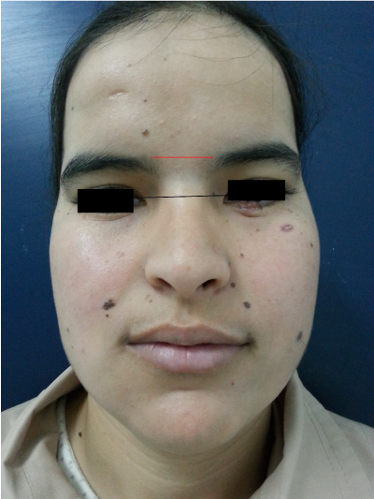
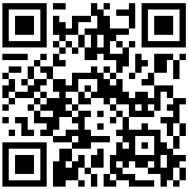



Living with Gorlin Syndrome: Quality of Life Findings from the National Registry
Jordan K. Bui, BS^{1,2}; Meredith Weiss, JD³; Jean R. Pickford, BS³; Joyce MC Teng, MD, PhD¹
1. Department of Dermatology, Stanford University School of Medicine 2. Georgetown University School of Medicine
3. Gorlin Syndrome Alliance
Background
Methods
The Gorlin Syndrome Alliance has a national registry for patients affected by Gorlin Syndrome (GS) or Nevoid Basal Cell Carcinoma Syndrome.
GS is a rare genetic disorder characterized by multiple basal cell carcinomas, odontogenic keratocystic tumors, skeletal anomalies, and other systemic manifestations.
Patients often face visible skin changes and recurrent procedures which may affect overall quality of life (QoL).
While clinical features and genetics of the syndrome have been well described, the psychosocial impact on has not been thoroughly investigated.
Participants can self enroll into the Gorlin Syndrome Alliance registry.
After registration, participants can access questionnaires about their medical history and receive information regarding new surveys.
A quality-of-life survey was sent out through this registry from June 2021-July 2025.
This survey consisted of nearly 50 questions asking participants about their self perception of themselves and their condition, how this may affect their interactions with others, and school/work activities.
Image from Lahcen et. al.
DOI: 10.15761/OHC.1000140
Results
There were 116 respondents and 92 participants completed the survey (79.3% completion rate).
33 participants were between 0-18 years old and 59 participants were 19 years old or older.
Table 2: Participant response summary from QOL questionnaire.
Over the past week, the participant felt this emotion all/most/a good bit of the time due to GS
Anxious | 28.3%
Sad | 21.7%
Angry | 13.0%
Over the past week, the participant felt worried about the following issues due to GS
Needing surgery or procedures | 43.5%
Lesions going deeper | 34.8%
Where the next lesion will appear | 33.7%
When the next lesion will appear | 32.6%
Over the past week, the participant avoided these activities due to GS all/most/a good bit of the time
Leisure/social activities |  | 16.3%
Intimate relationships |  | 15.2%
Meeting new people |  | 14.1%
Participants definitely/somewhat agreed to having these feelings about their appearance
Self-conscious |  | 50.0%
Insecure |  | 46.7%
Anxious when people look at them |  | 40.2%
Unhappy |  | 39.1%
Stressed |  | 35.9%
Depressed when they look in the mirror |  | 33.7%
Avoids friends/family because of their appearance |  | 17.4%
Table 1: Demographic summary of participants.
Race
White | 88.0%
Asian | 4.3%
Other | 2.2%
American Indian/Alaska Native | 2.2%
Black or African American | 2.2%
Native Hawaiian or Pacific Islander | 1.1%
Ethnicity
Not Hispanic/Latino | 95.7%
Hispanic/Latino | 3.3%
Declined | 1.1%
Gender
Female | 71.7%
Male | 28.3%
Age (in years)
Mean (Std. Deviation) | 33.2 (21.8)
Range | 0-73
Conclusion
As one of the largest survey studies for quality of life in GS, this project provides insight into how GS may impact individual self-perception and future more so than their interactions with the world around them.
While many individuals with GS reported maintaining social, leisure, and intimate relationships, nearly half expressed self-consciousness about appearance and fears about their future.
Anxiety, sadness, and worry about future lesions or surgeries were common, highlighting an emotional burden that may not be apparent from clinical assessments alone.
Our findings suggest that internal self-perception and future uncertainty may impact quality of life more than external social limitation in GS.
More research is needed to understand long-term psychosocial outcomes and to develop targeted support and counseling interventions for this population.
Scan the code to learn more about GS and joining the national registry!

